Slide 1
Project Management
Projects and Organizational Strategy

Slide 2
Strategic Management
Process of assessing “what we are”and deciding and implementing “what we intend to be and how we are going to get there”

Slide 3
Strategic Planning
Involves determining long term objectives by analyzing the strengths and weaknesses of an organization, studying opportunities and threats in the business environment (SWOT), predicting future trends , and projecting the need for new products and services

Slide 4
Why Project Managers Need to Understand the Strategic Management Process
provide an overall perspective of the organization focus
provide valuable insights concerning organizational capabilities and resource constraints
see present project in relation to other projects
facilitates reassignment of resources and priorities among projects

Slide 5
Strategic Management Process
1
Review/revise mission
External environment-- opportunities and threats
Internal environment-- strengths and weaknesses
New goals and objectives
2
Strategic Management Process Includes Four Activities
1. Review and define the organizational mission. 2. Set long-range goals and objectives. 3. Analyze and formulate strategies to reach objectives. 4. Implement strategies through projects.
Portfolio of strategic choices
3
Strategy formulation
Strategy implementation
4
Projects

Slide 6
Project Screening Process
Project proposal idea
Data collection and backup
Need strategic fit ROI/payback risk
Self evaluation of project by criteria
Abandon
Pursue
Periodic reassessment of priorities
Priority team evaluates proposal and reviews portfolio for risk balance
Return for more information
Reject
Accept
Assign priority Assign resources Assign project manager Evaluate progress
Hold for resources

Slide 7
Summary
Vision
Ideal
State
Mission
GAP
STRATEGIES
Strategic Formulation
Now
Strategic Implementation
PROJECTS

Slide 8
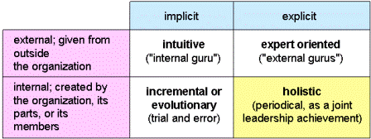
Identifying projects

Slide 9

Generic Project Selection Process

Slide 10
Project Selection Models

Slide 11
Stretch Scenario
Your boss tells you that you will be the PM for a new project that is a “priority for the company” and “won out” over many other potential projects. You ask what the selection process and criteria were that made this a priority. He glances at you as he says, “a $20 dollar lunch and big favor from the VP of Engineering.”
YOUR THOUGHTS?

Slide 12
Project Selection
“The proper choice of investment projects is crucial to the long-run survival of every firm.”
Project selection may and frequently does occur without the project management team’s participation

Slide 13
Two Basic Project Selection Models
Nonnumeric
Numeric

Slide 14
Nonnumeric Models
Sacred Cow - project is suggested by a senior and powerful official in the organization; maintained until successfully concluded or until the boss realizes the futility of it
Operating Necessity - the project is required to keep the system running; they are embarked upon with little management decision

Slide 15
Nonnumeric Models
Competitive Necessity - project is necessary to sustain a competitive position
Product Line Extension - projects are judged on how they fit with current product line, fill a gap, strengthen a weak link, or extend the line in a new desirable way.

Slide 16
Non Numeric Model
Comparative Benefit Model – a model used to select between diverse projects not easily comparable.
Q-Sorting
Forced Comparison
Peer Review
Murder Board
Profile Modelling

Slide 17
Q-Sorting
Structured group process. Each person given set of project cards.
Steps:
Each person sorts cards into HIGH or LOW priority–based on criteria
Cards reviewed & MEDIUM-priority projects extracted
HIGHs = HIGH or VERY HIGH. LOWs = LOW or VERY LOW. Now 5 piles
Results from all group members grouped & displayed.
Results surveyed by each person who can shift any card
Results displayed. Opportunity for members to reach consensus.
VERY HIGH first considered for funding
Group processes often deeply influenced by behavioural factors. Q-sorting tries to overcome these factors

Slide 18
Peer Review
Management want unbiased external assessment of proposed project.
Peer review = send proposal to experts to assess technical merits
Experts submit independent recommendations, or panel
Common in scientific areas particularly government funded R&D project proposals.
Advantages - assessment is expert and objective
However “peer review has long been criticised as a highly subjective approach that is susceptible to distortions, such as bias in favour of an old boy network”

Slide 19
Forced Comparison
Each department ranks projects they wish to take to selection board,
Each department’s top-ranked project is compared to every other department’s top-ranked project.
Board “selects one project based on their collective opinion as to the overall value of the project obtaining the organisation’s objectives”
As 1 project selected, that department introduces next project which is then compared to top-listed projects of other departments.
Process continues until all projects have been ranked.
Number of projects selected for approval will be based upon the availability of organisational resources

Slide 20
Profile Model
Rates projects qualitatively. No numerical assessments are made
Easy to read and quickly understood presentation.
Disadvantage - fails to inform whether a project scoring HIGH in certain criteria outweighs its MEDIUM & LOW scores in other criteria.
"Thus, there is no way to get a single overall score or rating for each project"

Slide 21
Profile Model
Project X has better profile and
is preferred to Project Y

Slide 22
Murder Board
A panel of people from different parts of organisation whose strongly scrutinise project proposals.
“they should tear it apart and try to show how it is not workable”
Proposer must present & defend project before the panel.
Purpose - “not to punish & humiliate project champion but rather to distinguish between solid and shaky propositions ... the murder board serves the function of ‘reality check’ ”
Usually used in conjunction with other selection methodologies

Slide 23
Which “Method” is This?
A group of reviewers challenges the project proponent
Hospital considers addition of new service because of decreased market share
Senior manager says we should introduce a new technology

Slide 24
A question re: Non-Numeric Selection Methods
What do you think are the strengths and weaknesses of non-numeric selection models?

Slide 25
Numeric Project Selection Models

Slide 26
Numeric Models: Profit/Profitability
Financial considerations are often “the” primary decision criteria for project selection
Three primary methods for determining the projected financial value of projects:
Net present value (NPV) analysis
Return on investment (ROI)
Payback analysis

Slide 27
Net Present Value Analysis
Net present value (NPV) analysis – calculates the expected net monetary gain or loss from a project by discounting all expected future cash inflows and outflows to the present point in time
Positive NPV - should consider selection of the project if financial value is a key criterion
The higher the NPV, the better!

Slide 28
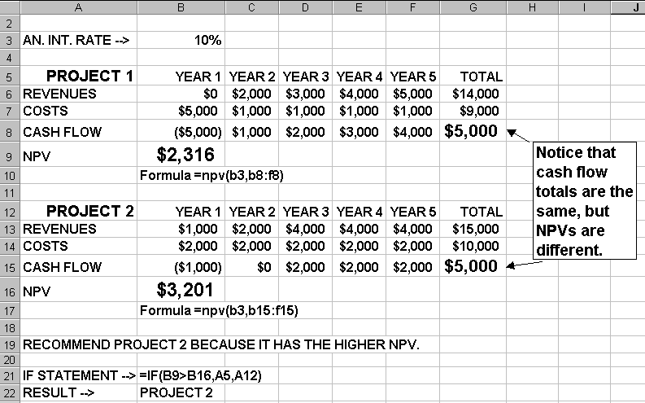
Net Present Value Example

Slide 29
Return on Investment
Return on investment (ROI) is income divided by investment
ROI = (total discounted benefits - total discounted costs) / discounted costs
The higher the ROI, the better
Many organizations have a required rate of return or minimum acceptable rate of return (MARR) on investment for projects

Slide 30
Payback Period Analysis
Payback Period - the amount of time it will take to recoup dollars invested in a project
Payback occurs when the cumulative discounted benefits and costs are greater than zero
Shorter the payback period the better

Slide 31
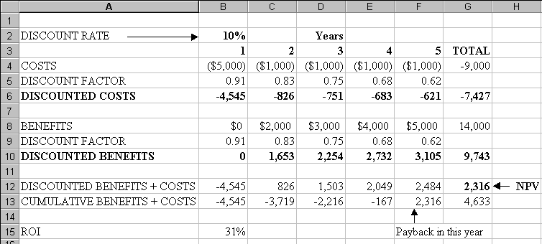
NPV, ROI, and Payback Analysis Analysis for Project X

Slide 32
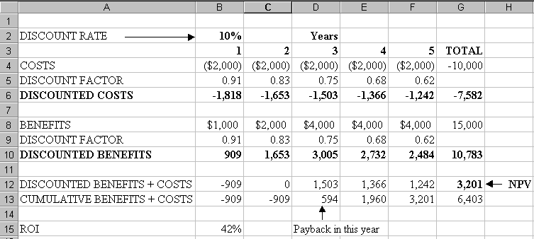
NPV, ROI, and Payback Analysis for Project Y

Slide 33
Short Exercise
What are the strengths and weaknesses of using the profitability models for project selection?

Slide 34
Numeric Models: Scoring
In an attempt to overcome some of the disadvantages of profitability models, particularly their focus on a single decision criterion, a number of evaluation/selection models hat use multiple criteria to evaluate a project have been developed. Such models vary widely in their complexity and information requirements. The examples discussed illustrate some of the different types of numeric scoring models.

Slide 35
Unweighted 0–1 Factor Model
A set of relevant factors is selected by management and then usually listed in a preprinted form. One or more raters score the project on each factor, depending on whether or not it qualifies for an individual criterion.
The raters are chosen by senior managers, for the most part from the rolls of senior management.
The criteria for choice are:
(1) a clear understanding of organizational goals
(2) a good knowledge of the firm’s potential project portfolio.
Notes:
Next slide: The columns are summed, projects with a sufficient number of qualifying factors may be selected.
Advantage: It uses several criteria in the decision process.
Disadvantage: It assumes all criteria are of equal importance and it allows for no gradation of the degree to which a specific project meets the various criteria.

Slide 36
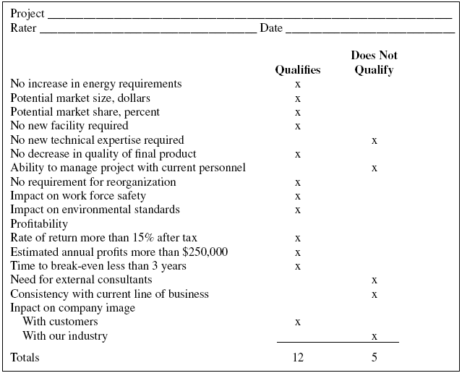

Slide 37
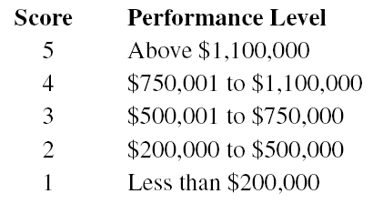
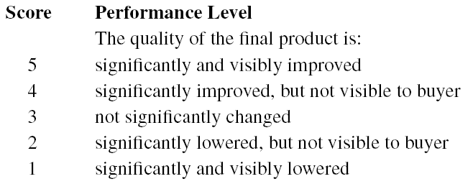
Unweighted Factor Scoring Model
X marks in 0-1 scoring model are replaced by numbers, from a 5 point scale.

Slide 38
Weighted Factor Scoring Model
When numeric weights reflecting the relative importance of each individual factor are added, we have a weighted factor scoring model. In general, it takes the form
where
Si the total score of the ith project,
Sij the score of the ith project on the jth criterion, and
Wj the weight of the jth criterion.

Slide 39
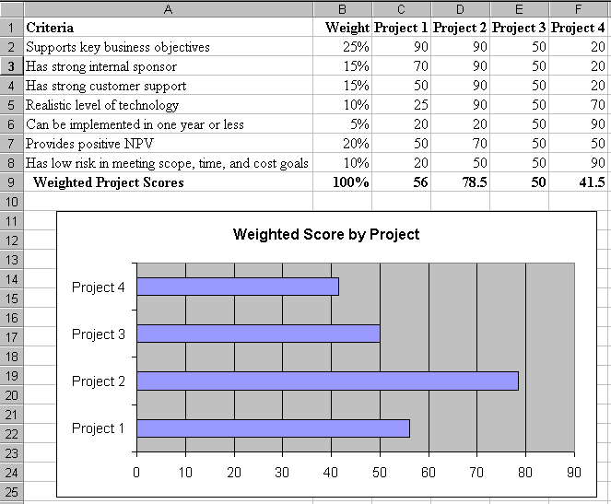
Sample Weighted Factor Scoring Model

Slide 40
Example: P & G practice
Would not consider a project to add a new consumer product or product line:
that cannot be marketed nationally;
that cannot be distributed through mass outlets (grocery stores, drugstores);
that will not generate gross revenues in excess of $—million; for which Procter & Gamble’s potential market share is not at least 50 percent;
and that does not utilize Procter & Gamble’s scientific expertise, manufacturing expertise, advertising expertise, or packaging and distribution expertise.

Slide 41
Numeric Modeling Issues
Focus only on the measurable/tangible
Adequacy of specification of model
Subjective – Objective – Subjective dilemma
Problem Formulation
Analytical approach
Interpretation
Deceiving numbers

